Slide 1
Apollo GNC Overview
D. Zimpfer
March 5, 2008
Go For Lunar Conference
Tempe, AZ
(thanks to numerous members of the ALHAT team that created the individual slides)

Slide 2
Apollo LEM Cockpit

Slide 3
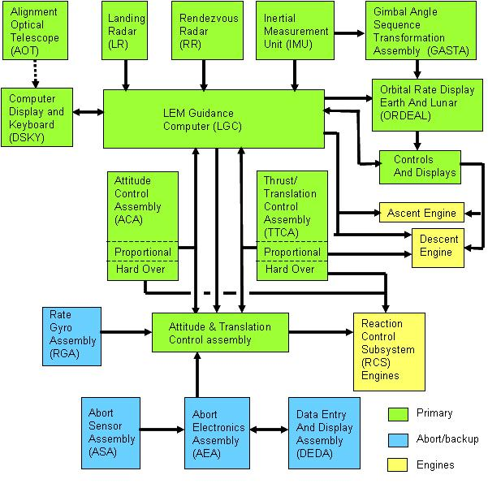
LEM GN&C Overview
Summary Produced by Northrop Grumman GN&C Engineers Howard Berman
(LM Flight Control System Integration/Analysis)
And
Mel Rimer
(LM Flight Control System Analysis/Synthesis)

Slide 4
Typical Apollo Lunar Descent Trajectory
Redesignation phase (146 sec typical length)
(96 sec for Apollo 12, 6 redesignations)
Apollo 12 Redesignation Phase
(Human eyes as HDA sensor)
 | Uprange from target [m] | Altitude [m] | Target view angle [deg] | Time till touchdown [sec]
Redesignation enabled | 6800 | 1950 | 16 | 202
First redesignation | 3800 | 800 | 12 | 172
Last redesignation | 490 | 122 | 14 | 114
Redesignation disabled | 470 | 115 | 14 | 106
Source:
“Apollo 12 Mission Report”, March 1970. Johnson Space Center. (NASA-TM-X-74200)
Note: Numbers are taken from figures throughout chapter 4. Values are approximate.
Source:
Klumpp, Allan. “Apollo Lunar-Descent Guidance”. June 1971. C.S. Draper Laboratory. (R-695) (Page 3, Figure 2)

Slide 5
Functional Flow of Apollo Astronauts and System
P67
Crew input
P66
P64
Draper, C.S., Whitaker, H.P., Young, L.R. “The Roles of Mend and Instruments in Control and Guidance Systems for Spacecraft.” 15th International Astronautical Congress, Poland, 1964.

Slide 6
Review Inputs During Descent
P64
Designate a new landing aim point (via rotational hand controller)
P65
Vehicle is pitched to the vertical position, translational velocities are nulled and the vertical-descent rate is set to 3 ft/sec
P66
“Semi-auto mode”
Crew controlled the attitude to maneuver the vehicle by commanding the nozzles in the form of an angular acceleration command signal
Altitude and altitude rate were held constant by the computer, the crew could change these through the Rate of Descent switch
P67
“Full manual mode”
Crew controlled engine throttle manually
Attitude was controlled by the Digital Autopilot
This mode was rarely used because of the high workload required

Slide 7
Autonomy – The debate is not new

